Slide 1


IIIF and Repositories: Managing Image Content and Integration Workflows
Claire Knowles
University of Edinburgh
Terry Brady
Georgetown University Library
Notes:
Hello.This is a two-heads-are-better-than-one talk, I’m Claire Knowles, Library Digital Development Manager at the University of Edinburgh and Terry Brady, a Developer at Georgetown University Library- I’d also like to thank two people that aren’t here- Scott Renton who had input into this presentation.

Slide 2

Introduction to IIIF
There is a better way
Photo by Sebastian Grochowicz on Unsplash

Slide 3
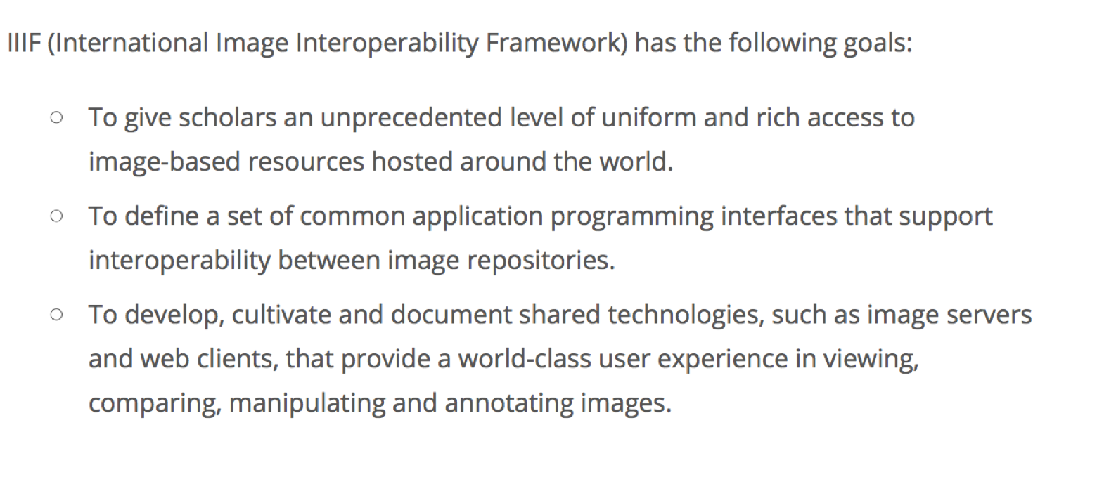
http://iiif.io/about/

Slide 4

IIIF: Two Core APIs
Image API
Presentation API
Just enough metadata to drive a remote viewing experience
“get pixels” via a simple, RESTful, web service

Slide 5
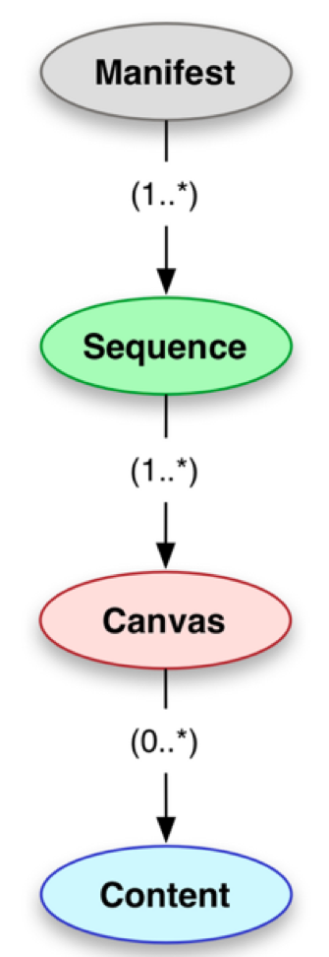
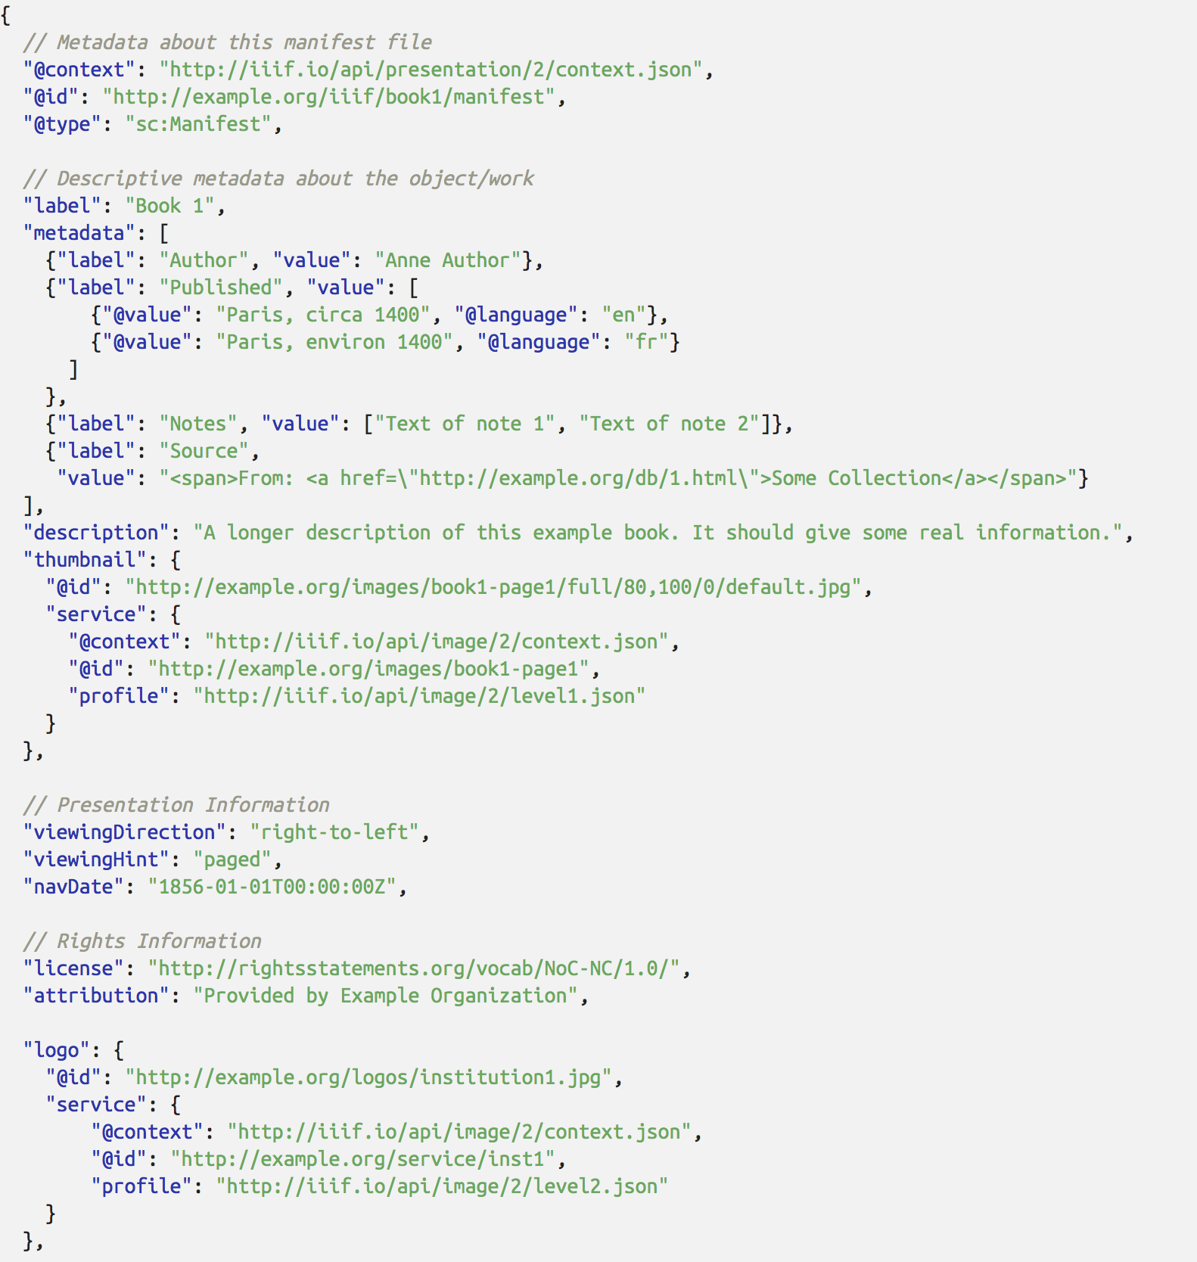
http://iiif.io/api/presentation/2.1/#basic-types

Slide 6
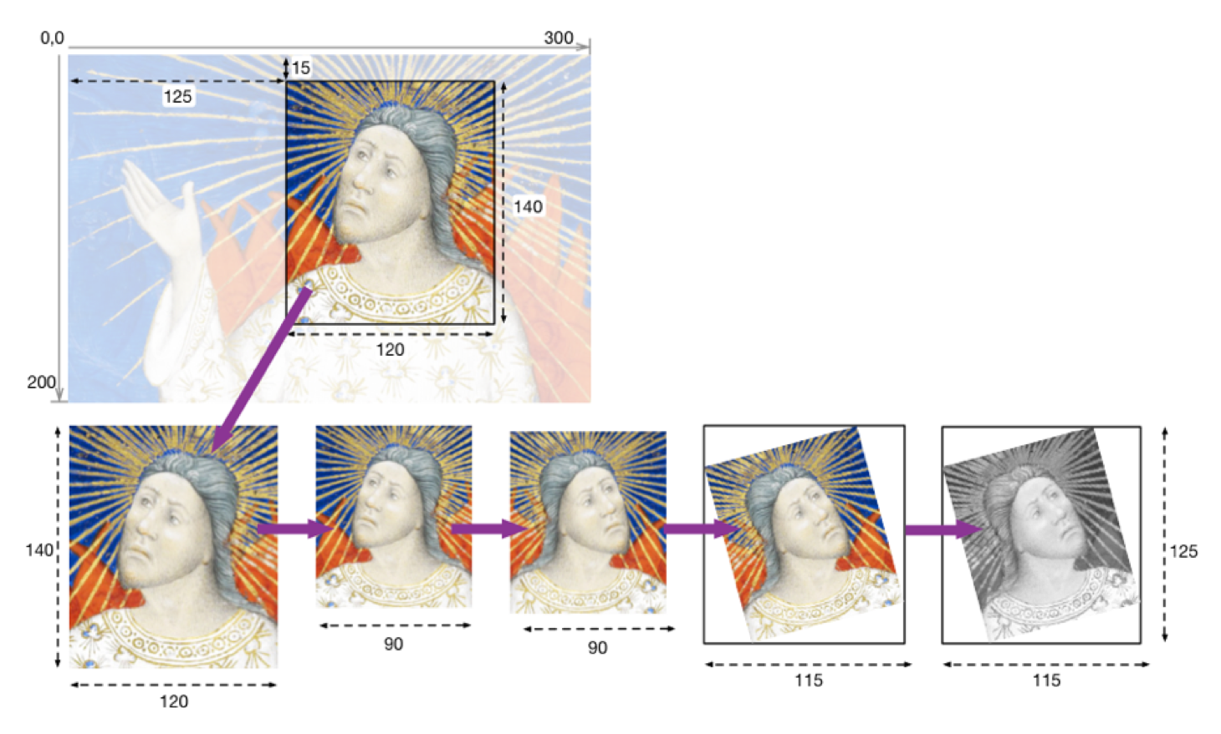
From http://iiif.io/api/image/2.1/#order-of-implementation

Slide 7
Common Discoveries
At Edinburgh and Georgetown
Notes:
It’s a pleasure to present jointly with Terry today. We’ve spoken rather a lot over the past year over Skype, usually with Claire, and it is great to finally meet in person. The main reason we’ve been working closely is that we have identified a lot of commonality across our repository estates, have both enthusiastically adopted IIIF, and are resultantly finding common issues and needs.

Slide 8
Common Discoveries
Our conversation started as “IIIF and DSpace”
Awesome Opportunities with IIIF
Great Interoperability
And Some Challenges
How does the repository fit with IIIF?
Notes:
The repositories of which we speak are largely DSpace- this may be known to some of you- it’s popular Open Source software within the scholarly community in the same space as Fedora and ePrints, and can be creatively used to store diverse content outside of the realm of journals, theses and publications. We could both see great potential for bringing IIIF into our respective workflows, and it’s really interesting to see what’s come out. The interoperability potential of IIIF is something we’ve seen results of already, but as always, integration presents challenges as well. Where are we making the best use around what we have?

Slide 9
IIIF - Opportunities and Questions
Opportunities:
Representing complex objects
Representing hierarchical collections and objects (Archival)
Questions:
Where to author metadata?
Iterative generation of manifests
Where should manifests be stored?
What identifiers to utilize?
Notes:
These are the sorts of things that both institutions have come across, and we will mention many of them in our separate presentations. I’m now delighted to introduce an almost local boy: his institution is in this city- he just happens to live hundreds of miles away! Terry Brady.

Slide 10
DigitalGeorgetown and IIIF
Terry Brady
Georgetown University Library
https://github.com/terrywbrady/info
Notes:
Terry will lead this section (8 min)

Slide 11

DigitalGeorgetown
Institutional Repository and Digital Collections
One IIIF Collection So Far
Universal Viewer embedded in DSpace
Future IIIF Collections in Planning
https://repository.library.georgetown.edu

Slide 12
Our First IIIF Collection - Mar 2018
Manuscript Collection of digitized comic books
Recently digitized
Visually interesting
Item metadata already exists in DSpace

Slide 13
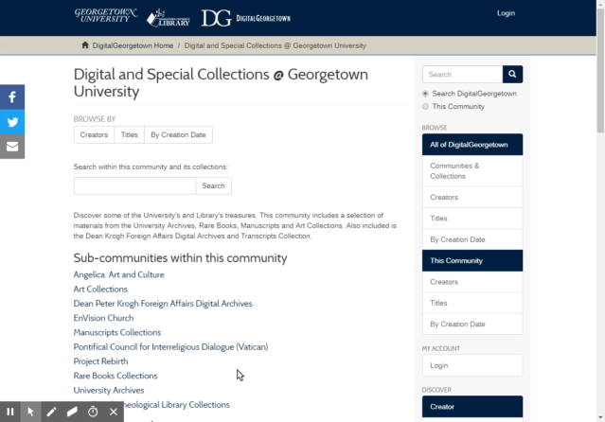
Manuscript Collection with Item Metadata
https://repository.library.georgetown.edu/handle/10822/1044538#?m=7

Slide 14
Digitized Archival Collection with Item Metadata in DSpace
Folder
Folder Name
Image
Image
Metadata
Folder
Folder
Image
Image
Folder
Folder
Folder
Folder
Image
Image
Image
Images
Image
Images
Metadata
Metadata
Metadata
Metadata
Descriptive metadata already exists in DSpace

Slide 15
A future digital collection from our Law Center
Digitized archival collection
No item level metadata
Conceptually difficult to imagine as items
Only box/folder descriptive information in an EAD
Digitized folders are named to match EAD container labels

Slide 16
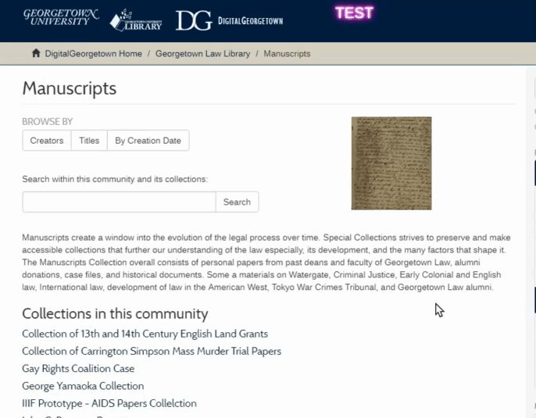
Manuscript Collection with Only EAD Metadata
This collection is still under development

Slide 17
Digitized Archival Collection with Folder Metadata as EAD
Folder
Folder Name
EAD Container
Image
Image
Folder
Folder
Image
Image
Folder
Folder
Folder
Folder
Image
Image
Image
Image
Image
Image
Item metadata does not exist. Descriptive metadata is at the box and folder level.
EAD
(hierarchical desc)

Slide 18
DigitalGeorgetown Approach
Re-use existing metadata wherever possible
Author metadata where it makes the most sense
DSpace, ArchivesSpace, CSV
Store digitized images in an accessible work area
Iteratively generate manifest files
Manifest Generation done by Digital Services team

Slide 19
DigitalGeorgetown Manifest Generation
Image File System
Accessible to a IIIF Image Server and as a shared drive for the digital services team
manifest
Collection
Images
mets
dc
DSpace
Collection
Universal Viewer
csv
File Analyzer
Images
Excel
Iiif image requests
Collection
Images
EAD
Loris
(Image Server)
ArchivesSpace

Slide 20
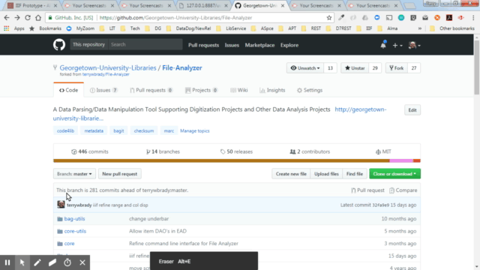
File Analyzer Manifest Generator Tool
Try it Out!
http://georgetown-university-libraries.github.io/File-Analyzer-Test-Data/iiif/

Slide 21
How has IIIF Changed
Our Architecture?

Slide 22
DigitalGeorgetown (before 2016)
Network Storage
TIF files
PDF file
Preservation Media
JPG files
PDF file
Access Media
DSpace
PDF Viewer
(js based)

Slide 23
DigitalGeorgetown - APTrust Preservation (2016)
Academic Preservation Trust
TIF files
PDF file
Preservation Media
JPG files
PDF file
Access Media
DSpace
PDF Viewer
(js based)

Slide 24
DigitalGeorgetown - IIIF Viewer Added 2018
Preservation Media
Academic Preservation Trust
Higher Res Media
IIIF Image Server
Access Media
DSpace
Manifest Files

Slide 25
How do these IIIF assets relate to the repository?
Preservation Media
Academic Preservation Trust
Higher Res Media
IIIF Image Server
Access Media
DSpace
Manifest Files

Slide 26
Why aren’t these assets stored in the repository?

Slide 27
DigitalGeorgetown IIIF Assets
Derived from preservation assets
Impractical as downloadable assets within DSpace
Size
Multi-page documents
High amount of iteration/experimentation with manifest contents
In an archival collection, what is an item?

Slide 28
What do we lose by not utilizing the repository?

Slide 29
Why we would want to use the repository
Proven technology
Handle/id persistence
Provenance Tracking
Manifest assembly is intellectual content

Slide 30
Current Rationale
IIIF Collections will grow slowly
Lots of iteration and manual verification
Unique Identifiers are derived from repository assigned identifiers
May be imperfect so far
Manifests
Served from file system
Or from the repository

Slide 31
Repository Development with IIIF
at University of Edinburgh
. . . in three acts
Claire Knowles
University of Edinburgh
Library and University Collections
Notes:
In Scotland, we have an expression about "painting the Forth Bridge". It's basically describing a constant task of review and renewal) because by the time you've finished, it needs doing again. It's the approach I think we all take to our repositories, always looking for ways to improve them.
What is the Forth Bridge? Basically there's a rail bridge and a road bridge, and there have been two for many years wit a third having recently been built (much to the chagrin of the owner of the "Two Bridges" restaurant at the waterfront. They're the direct route to a place called Fife, which isn't all lovely, but does have some very famous golf courses, or in the other direction, the way into Edinburgh.!
I would like to mention at the outset that we have really only applied IIIF to our repositories that deal with Special Collections data, essentially because that is where the images are. The examples I’ll show will be mainly around our core repository, with some interesting offshoots.

Slide 32
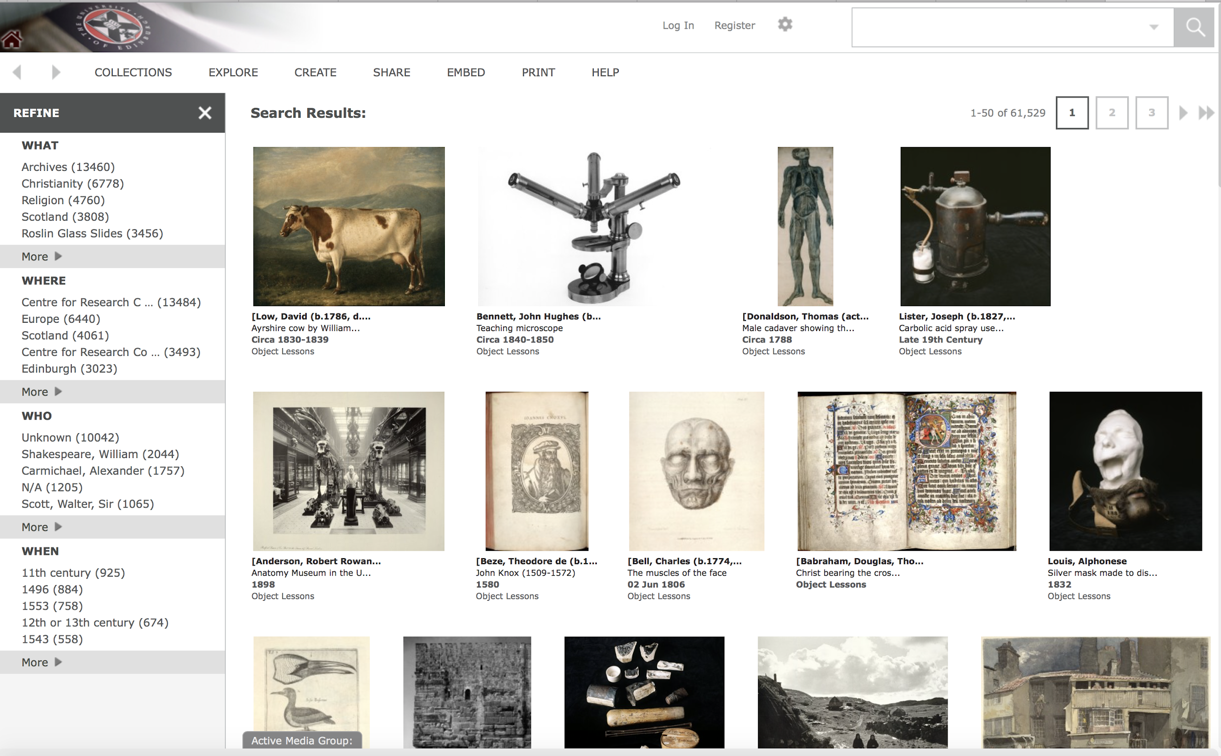
I) Classic Image Repository
Notes:
The idea of having a safe and searchable home for our theses, journals, archives, museums items and rare books contents is steadfast, and to the human eye, great to look at.

Slide 33
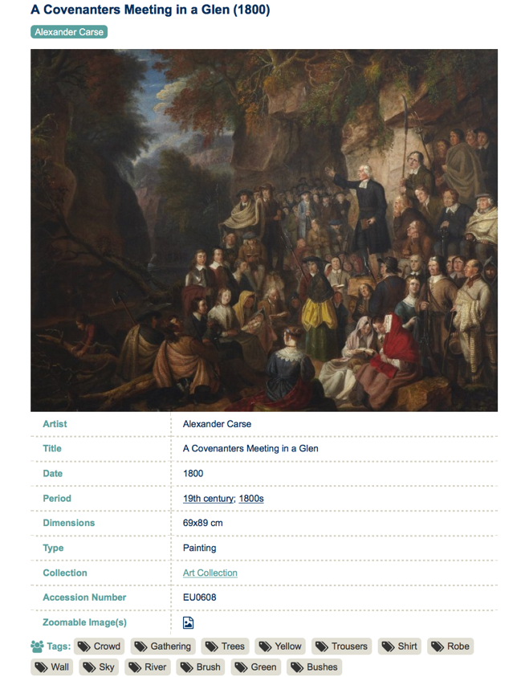
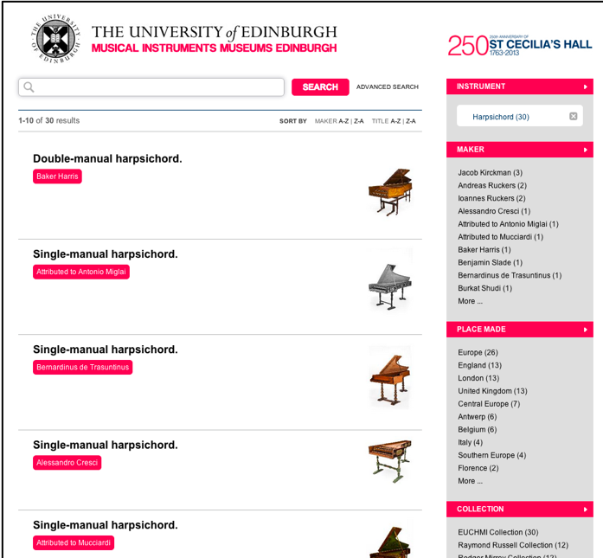
II) Skylight and a new front end
Notes:
This represents our digital repositories- DSpace, which we use as our repository of choice for scholarly content, but also for collections material, with a PHP skin (skylight) sitting atop it; Vernon, our golden copy musuems Collections management system (which feeds DSpace), and LUNA, our image repository, which has been giving us high-resolution zoom and great image management for many years. I suppose, up until fairly recently, we were using very trustworthy systems

Slide 34
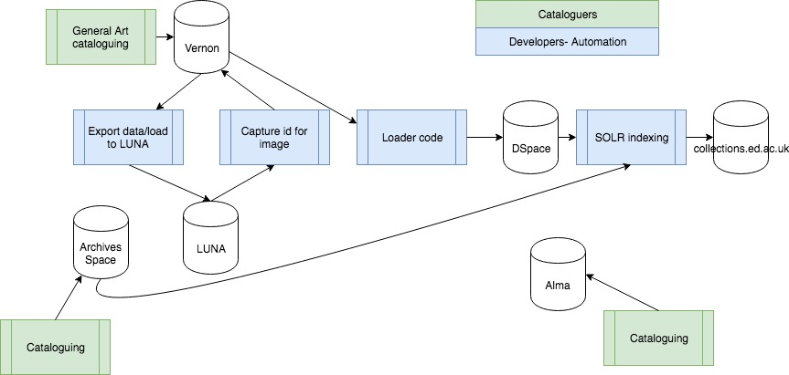
Behind the scenes
Notes:
So, this is where we were. Lots of good things going on- you can see that generally we like to author outside of our core dspace for Special Collections material- it’s not always the case, but in the main, museums objects, rare books and archives have separate homes and that can be brought together. LUNA, meanwhile takes a light catalogue largely done by photographers for identification, and where possible we enhance that record with catalogue data. Basically the above workflow means that, before IIIF, we could get our stuff out there, but there were some things we weren’t completely happy with: shifting derivatives from one server to another or requiring another click to get at the high-res image.

Slide 35
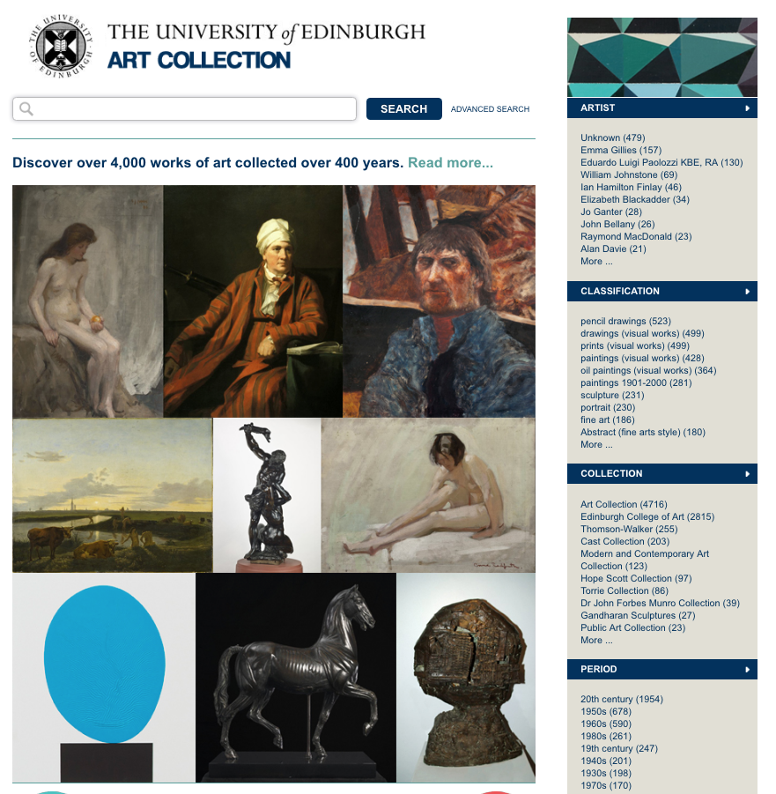
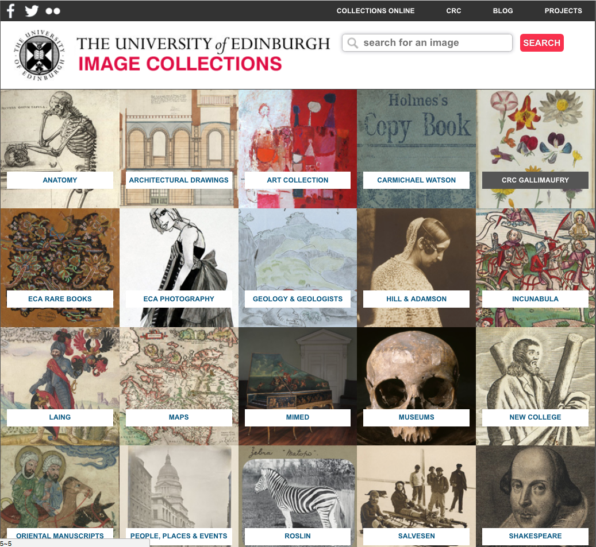
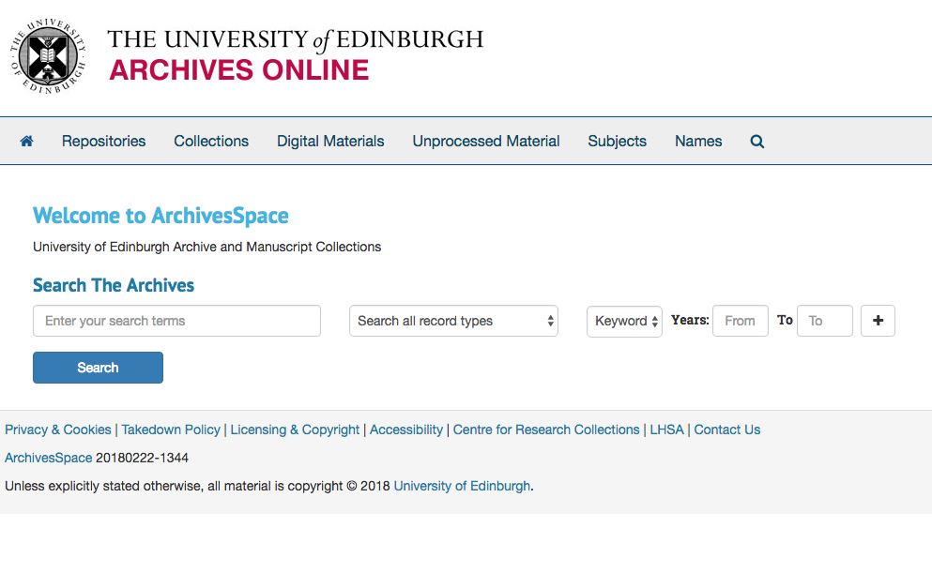
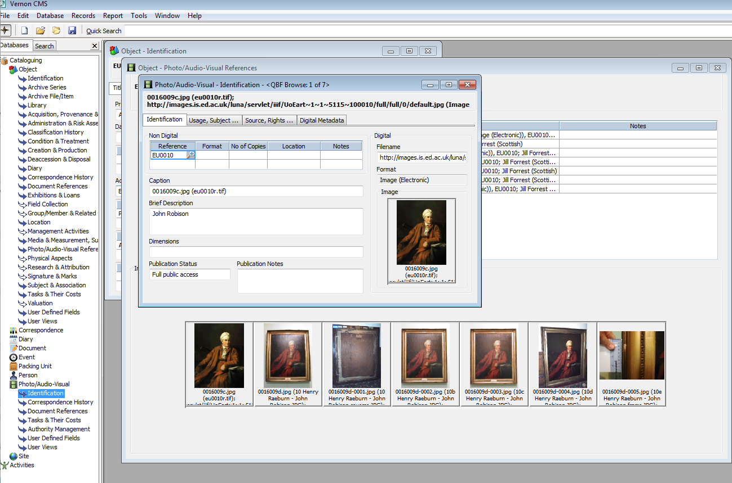
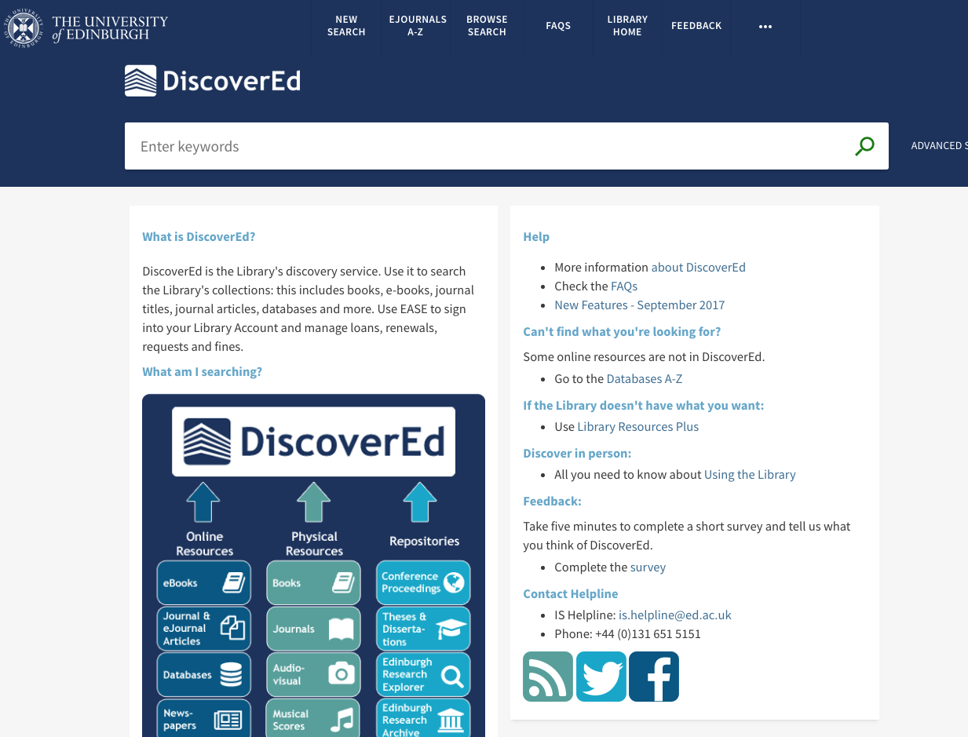
...in the right direction.
archives.collections.ed.ac.uk - collections.ed.ac.uk images.is.ed.ac.uk - discovered.ed.ac.uk
Notes:
But basically, we have systems that to an extent were pointed to interoperate. These are the solid struts, and we know that the bridge won’t fall down.

Slide 36
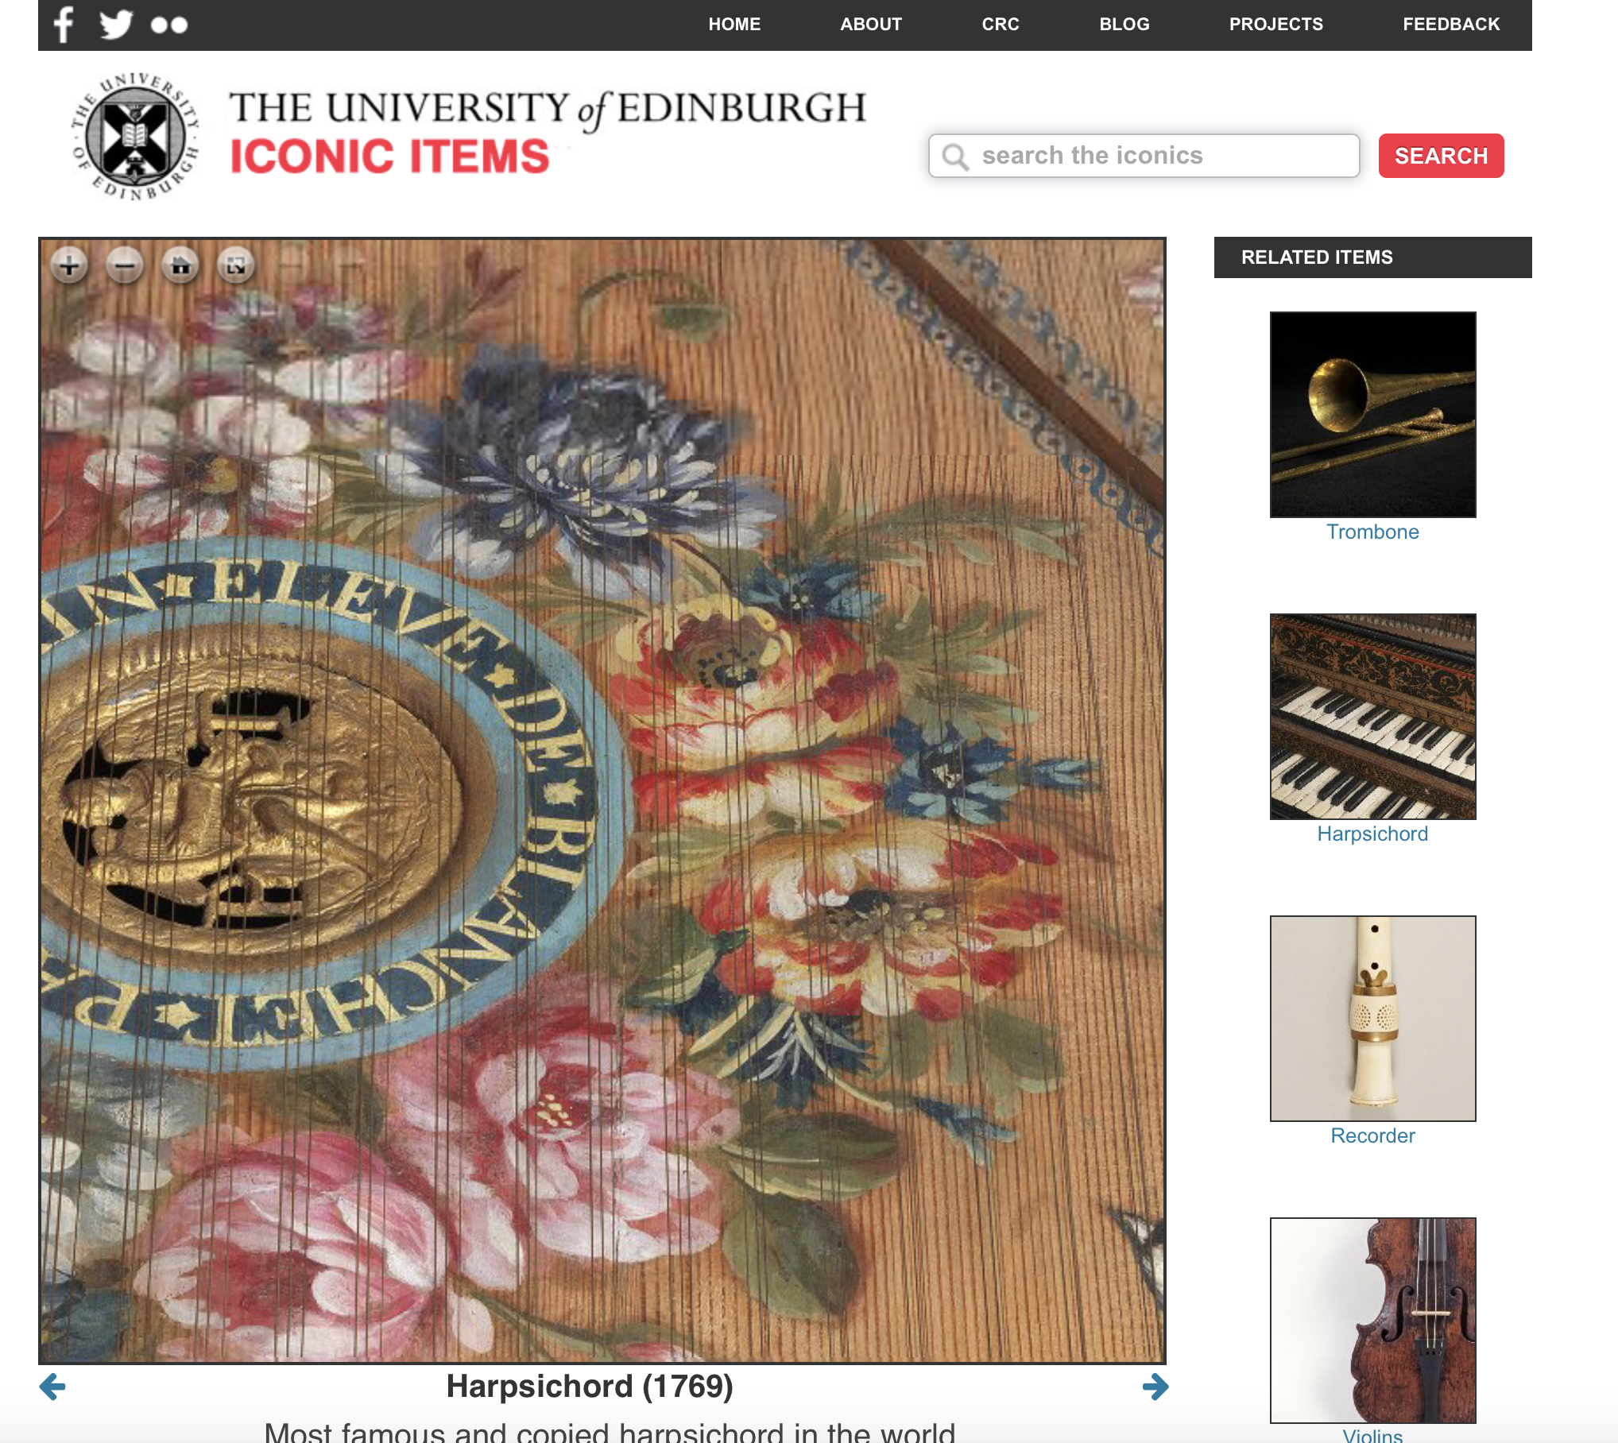
III) IIIF
Notes:
IIIF
IIIF though, as Terry has said, was sold to us as a means to make a lot of our repository workflow cleaner and smoother, and we’ll talk a bit now about how we’ve tried to apply it.

Slide 37
Why IIIF?
Notes:
Initially, the big thing we saw we could do was get the separate link, the need to have good metadata in two places and the need to move images around away by embedding high res zoom, and calling thumbnails from URLs in our front ends. Initially we looked at OpenSeadragon using DZIs, experimented with Digilib and IIPServer, but everything really opened out when LUNA told us they were implementing IIIF. All of our images became IIIF ready overnight, with info.jsons and individual manifests.

Slide 38
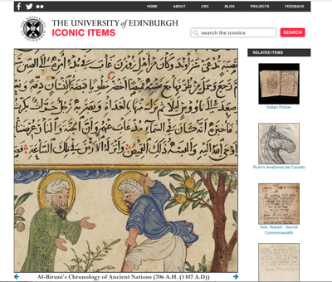
Phase 1: Image API
collections.ed.ac.uk/iconics
Notes:
So, we were able to start applying IIIF as Image API wherever we could. The first site we updated with embedded zoom was the above Iconics site. We also updated our museums CMS- Vernon- to use IIIF URLs for all image references, and updated our metadata games site to use IIIF images, and take some LUNA metadata down from the info.json (we now know this might need to be suppressed- but we just change the parser to use the manifest).

Slide 39
Manifests:
Where?
How?
What?
Notes:
We know that the Image API is a great start, but that the meat of the interoperability is done with presentation API, so we needed to get cracking on manifest creation. Obviously this opened up all sorts of questions- on the fly manifests or permanent locations? How should they be named? What sort of information should they carry?

Slide 40
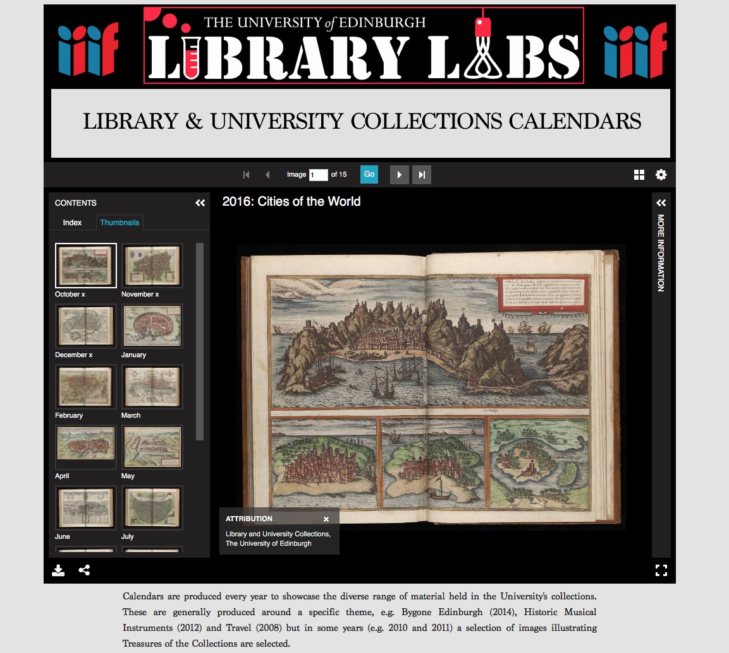
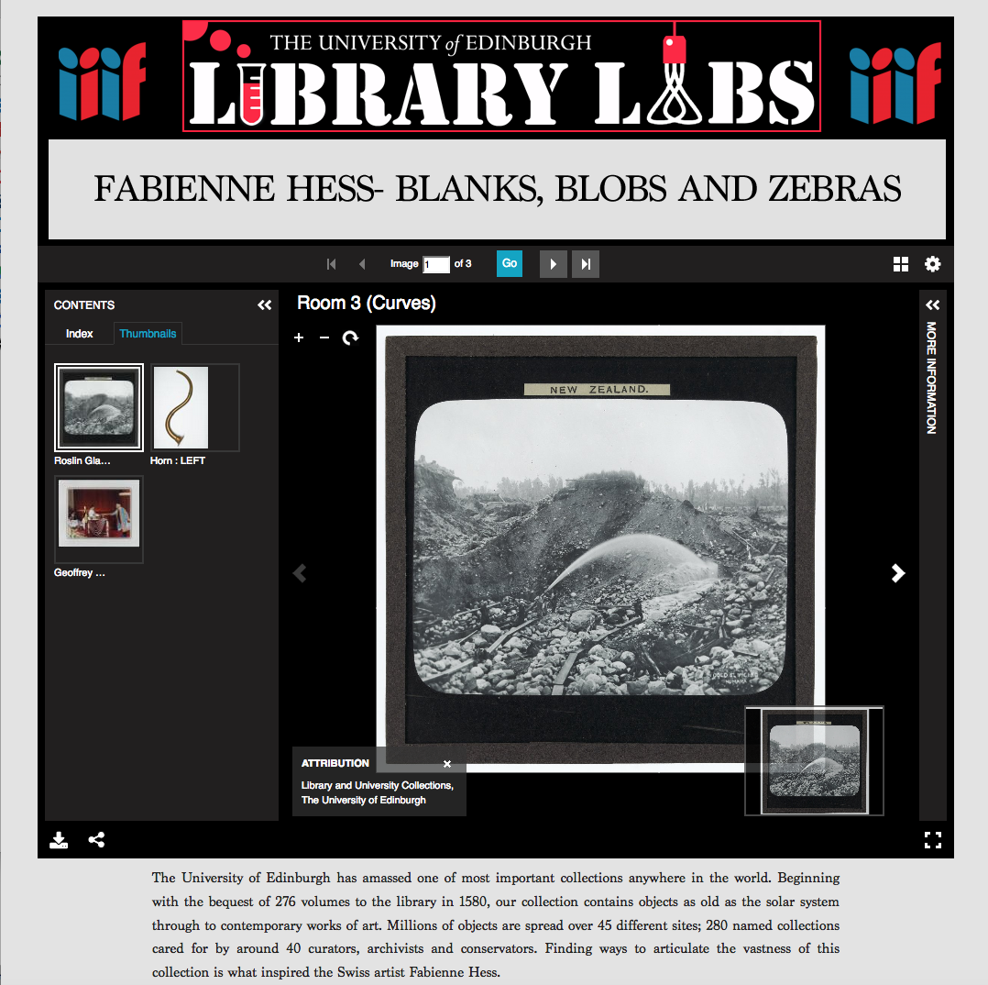
Phase 2: Presentation API
librarylabs.ed.ac.uk/iiif/calendars - librarylabs.ed.ac.uk/argyle-rooms
Notes:
Initially, we looked at some IIIF-only repositories (which obviously tap into LUNA). These were great for showing the potential of user development- simply build up a CSV, give it to us, we turn it into a manifest, and it’s done. We lose a little bit of the descriptive content, but that can be done manually. These were really useful to relay to people what a manifest is, and what a collection is.

Slide 41
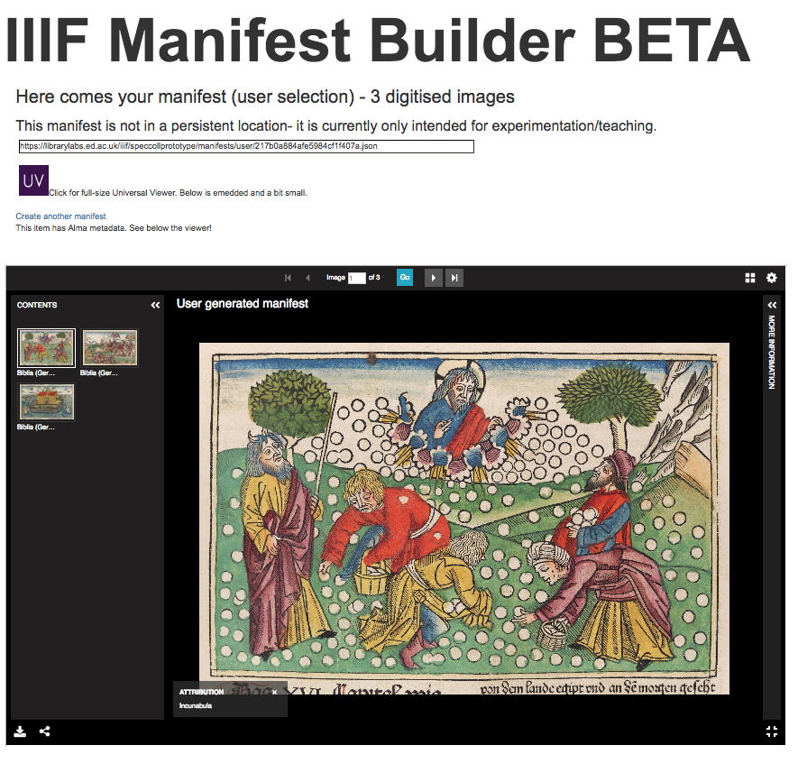
Phase 2: Presentation API
librarylabs.ed.ac.uk/iiif/speccollprototype/manifestbuild.php
Notes:
We’ve also created a UV-driving manifest builder, which can give users quick access to packaged up images where digitisation has taken place.

Slide 42
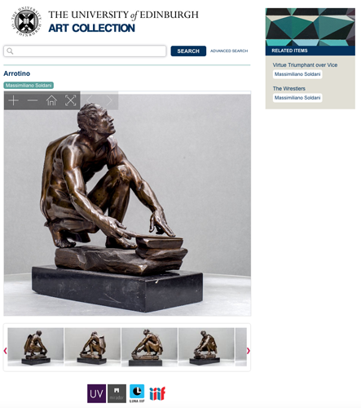
Phase 2: Presentation API
collections.ed.ac.uk/art
Notes:
Getting to the point of making manifests available was a big win. The collections repositories for museums material was actually quite easy, because the CMS knows which images relate to which items. Therefore, when loading into the repository you can generate it programmatically, and give it a persistent URI based on its handle. The only problem is that on first load, we cannot predict the URI for the manifest @id, so revisiting is required! We’re pushing on with this for Rare Books and Manuscripts, using this model, but with integrated UV based on shelfmark.

Slide 43
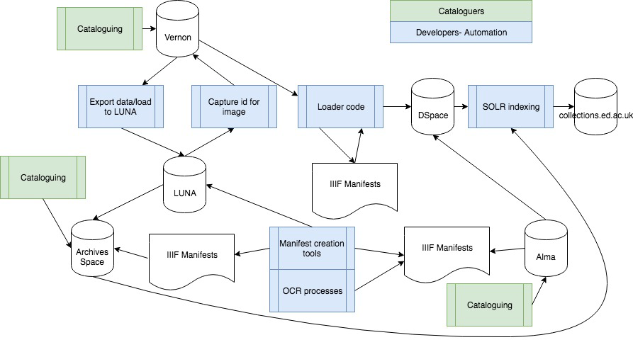
Behind the scenes mk2
Notes:
This has all made for a more joined-up workflow. Manifests become key to enhancing records where possible, but it is still very much about image availability. Our next step probably has to be to move beyond this to making the manifest more “the repository” and not just enhancing what we have.

Slide 44
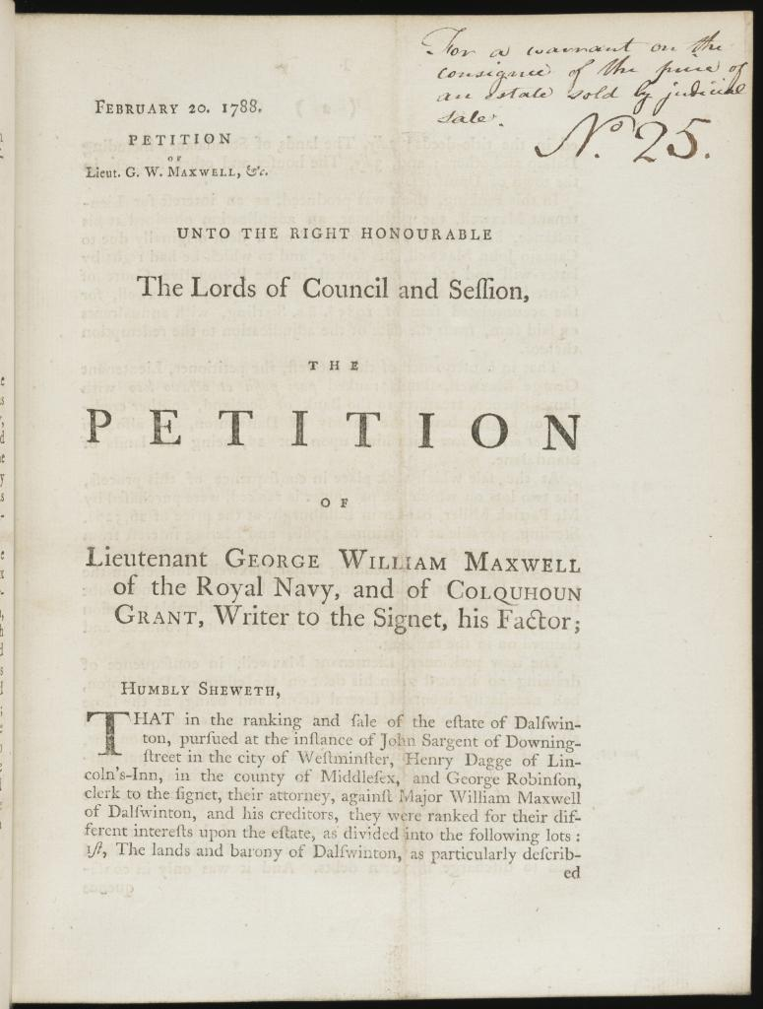
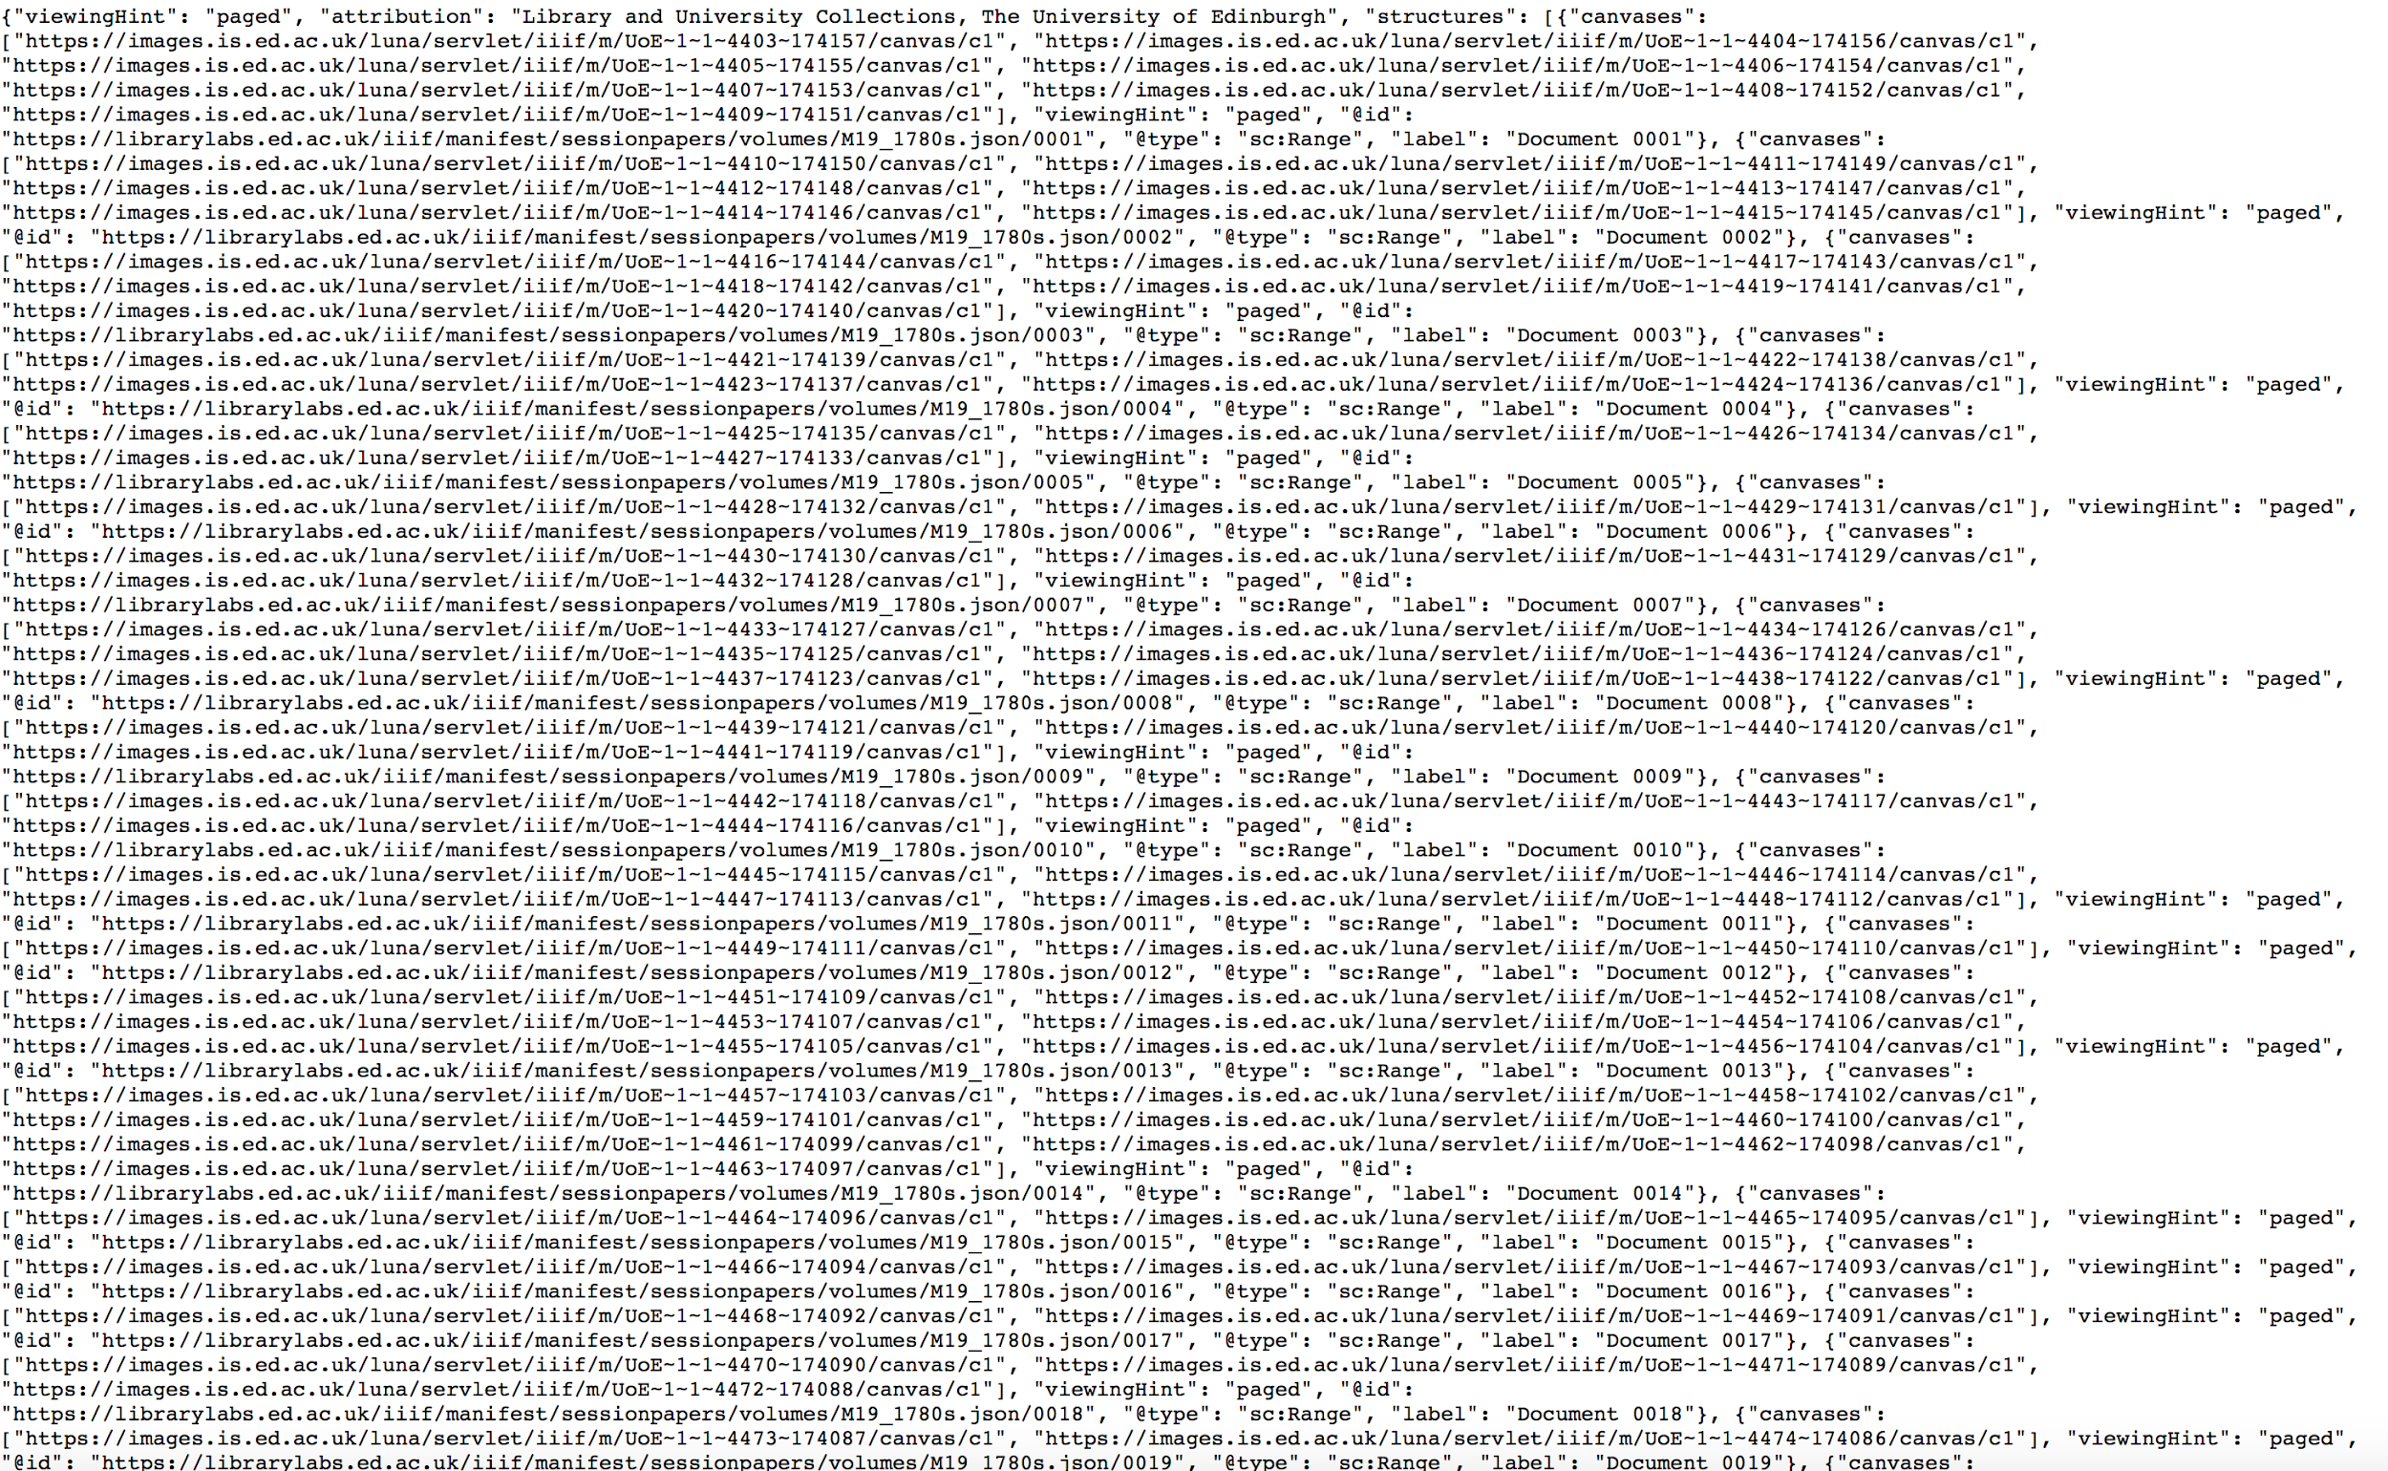
Complexity and challenges - Scottish Session Papers
Notes:
There is further complexity that we are trying to get IIIF to address. The Scottish Session Papers have no metadata and need OCR data pushed into a manifest to make them searchable, and my colleague Mike Bennett has done lots of great work on that.

Slide 45
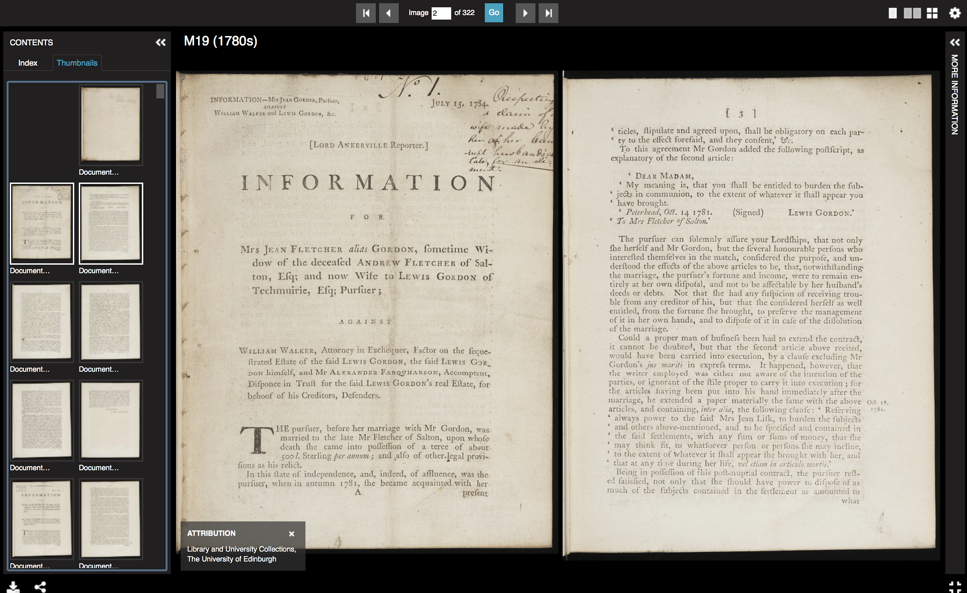
https://librarylabs.ed.ac.uk/iiif/uv/?manifest=https://librarylabs.ed.ac.uk/iiif/manifest/sessionpapers/volumes/M19_1780s.json#?c=0&m=0&s=0&cv=1&xywh=-1%2C-142%2C7595%2C5146

Slide 46
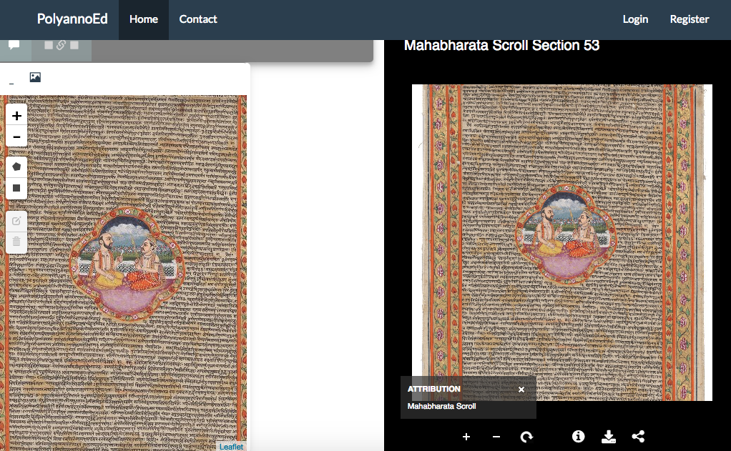
What’s happening next
https://www.youtube.com/watch?v=spYehaknO_A&feature=youtu.be
Notes:
Polyanno- Erin Nolan’s crowdsourced translation and transcription tool- effectively is its own repository with an annotation server underlying it, and as a new build, that’s a great solution. The 72m Mahabharata Scroll is a complete outlier- it is digitised using standard workflows, but its presentation is quite separate. We’re also aware of some issues that we need to resolve- the @id on the manifest, how to get a download when we don’t go direct to the LUNA page, and where we store manifests that cannot be so easily attached to a repository object.

Slide 47
Conclusions
(Questions Really)
Notes:
Terry will lead this section (2 min)

Slide 48
IIIF Digital Assets
What assets should be created?
Where should these assets be stored?
What role should the repository play in the management of these assets?

Slide 49
IIIF Manifest Components
Digital Asset URL’s
Manifest Metadata (Attribution, Logo)
Asset Metadata (Title, Date)
Asset Sequences
Asset Ranges (index)
Annotations

Slide 50
IIIF Manifest Files
How should a IIIF manifest be managed by a repository?
Does the manifest itself alter the notion of a repository collection or a repository item?
What are the proper identifiers to use for components of a IIIF manifest?

Slide 51
Thank You
Claire Knowles
University of Edinburgh Library
http://www.claireknowles.co.uk
Terry Brady
Georgetown University Library
https://github.com/terrywbrady/info
...and thanks to Scott Renton (Edinburgh)

